Slide 1
Intrusion Detection

Slide 2
Information security is defined
as methods and technologies
for deterrence (scaring away hackers), protection, detection, response, recovery and extended functionalities

Slide 3
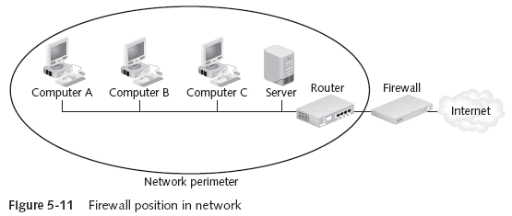
Overview of Existing Security Systems : Firewalls Used even for Deterring (Scaring attackers)
Firewalls → Designed to prevent malicious packets from entering
Software based → Runs as a local program to protect one computer (personal firewall) or as a program on a separate computer (network firewall) to protect the network
Hardware based → separate devices that protect the entire network (network firewalls)

Slide 4
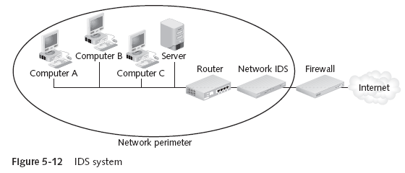
Overview of Existing Security Systems : Detection -Intrusion Detection Systems
Intrusion Detection System (IDS) → Examines the activity on a network
Goal is to detect intrusions and take action
Two types of IDS:
Host-based IDS → Installed on a server or other computers (sometimes all)
Monitors traffic to and from that particular computer
Network-based IDS → Located behind the firewall and monitors all network traffic

Slide 5
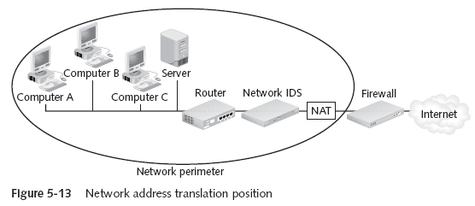
Overview of Existing Security Systems : Network Address Translation (NAT)
Network Address Translation (NAT) Systems → Hides the IP address of network devices
Located just behind the firewall. NAT device uses an alias IP address in place of the sending machine’s real one “You cannot attack what you can’t see”

Slide 6
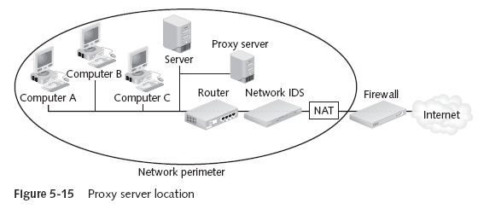
Overview of Existing Security Systems : Proxy Servers
Proxy Server → Operates similar to NAT, but also examines packets to look for malicious content Replaces the protected computer’s IP address with the proxy server’s address
Protected computers never have a direct connection outside the networkThe proxy server intercepts requests. Acts “on behalf of” the requesting client

Slide 7
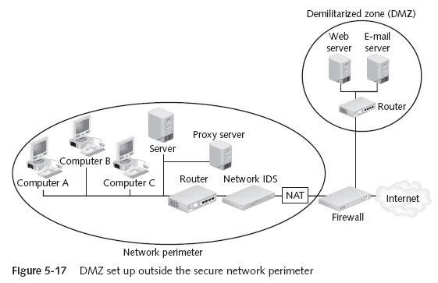
Adding a Special Network called Demilitarized Zone (DMZ)
Demilitarized Zones (DMZ) → Another network that sits outside the secure network perimeter. Outside users can access the DMZ, but not the secure network
Some DMZs use two firewalls. This prevents outside users from even accessing the internal firewall → Provides an additional layer of security

Slide 8
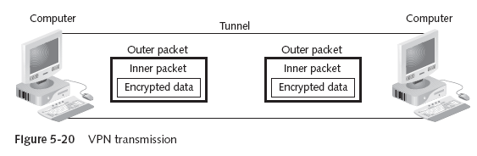
Overview of Existing Security Systems : Virtual Private Networks (VPN)
Virtual Private Networks (VPNs) → A secure network connection over a public network
Allows mobile users to securely access information
Sets up a unique connection called a tunnel

Slide 9
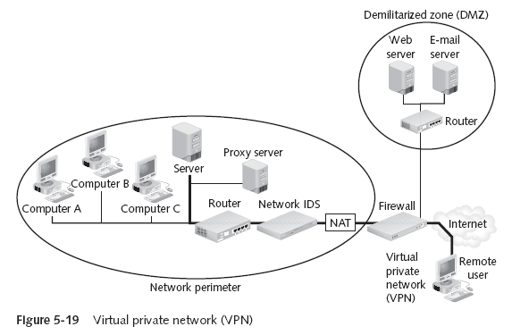
Overview of Existing Security Systems : Virtual Private Networks (VPN)

Slide 10
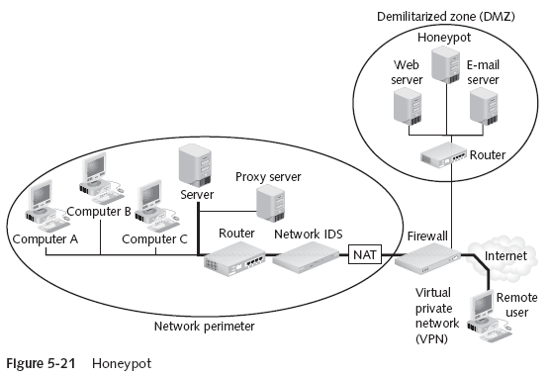
Overview of Existing Security Systems : Honeypots
Honeypots → Computer located in a DMZ and loaded with files and software that appear to be authentic, but are actually imitations
Intentionally configured with security holes
Goals: Direct attacker’s attention away from real targets; Examine the techniques used by hackers

Slide 11
Overview of Existing Security Systems : Secure Socket Layer (SSL)
SSL is used for securing communication between clients and servers. It provides mainly confidentiality, integrity and authentication
Establish SSL connection - communication protected
Client
WWW Server

Slide 12
Protecting one Computer
Operating system hardening is the process of making a PC operating system more secure
Patch management
Antivirus software – to protect your pc from viruses
Antispyware software
Firewalls – to deter (scare), protect
Setting correct permissions for shares
Intrusion detection Systems – to detect intrusions
Cryptographic systems

Slide 13
Intrusion and Intrusion Detection
Intrusion : Attempting to break into or misuse your system.
Intruders may be from outside the network or legitimate users of the network.
Intrusion can be a physical, system or remote intrusion.

Slide 14
Intrusion
Any unauthorized access, not permitted attempt to access/damage or malicious use of information resources
Intrusion Detection
Detection of break-ins and break-in attempts via automated software systems
Intrusion Detection Systems(IDS)
Defense systems, which detect and possibly prevent intrusion detection activities

Slide 15
What is NOT An IDS ?
Network logging systems
Security Scanners
vulnerability assessment tools to check flaws in OS,N/W
Antivirus products
Security/Cryptographic systems
E.g. VPN,SSL, Kerbose
Firewalls

Slide 16
Why IDS
Straight Forward Reason
to protect data and system integrity.
Fact :
can not be done with ordinary password and file security
Misconception :
A network firewall will keep the bad guys off my network,
My anti-virus will recognize and get rid of any virus I might catch,
And my password-protected access control will stop the office cleaner trawling through my network after I've gone home

Slide 17
Anti-virus systems are only good at detecting viruses they already know about.
Passwords can be hacked or stolen or changed by other.
Firewalls DO NOT recognize attacks and block them
Simply a fence around your network
no capacity to detect someone is trying to break-in(digging a hole underneath it)
Can’t determine whether somebody coming through gate is allowed to enter or not.
Roughly 80% of financial losses occur hacking from inside the network
“ Major problem with INTERNAL INTRUDERS ”

Slide 18
ID- A Brief History
1980 - James Anderson Paper Computer Security Threat Monitoring and Surveillance
Concept of “detecting” misuse and specific user events emerged
1984 - Dr. Dorothy Denning and SRI developed first model for intrusion detection, Intrusion Detection Expert System developed
1988 – HayStack Project at University of California Lab, released intrusion detection system for US Air force
1989 – Commercial company HayStack Labs released Stalker
1990 – UC’s Todd Heberlein introduced idea of Network Detection System”
Developed Network Security Monitor
SAIC developed Computer Misuse Detection System

Slide 19
US Air force developed Automated Security Measurement System
ID Market gain popularity around 1997
1998 ISS developed RealSecure
Cisco purchased Wheel Group
First host-based detection company Centrax Corporation emerged
Currently IDS is the top selling security technology

Slide 20

Typical intrusion scenario
-Find as much as info. As possible
-whois lookup and DNS Zone transfers
-Normal browsing ; gather important info.
Information Gathering
-ping sweeps, port scanning
-web server vulnerabilities
-version of application/services
Further Information Gathering
Attack !
-start trying out different attacks
- UNICODE attack if has IIS installed
-try to find misconfigured running services
-Passive Attack / Active Attack
Successful Intrusion
-install own backdoors and delete log files
-replace existing services with own Trojen horses that have backdoor passwords or create own user accounts
Steal confidential information
Use compromised host to lunch further attacks
- Change the web-site for FUN
Fun and Profit

Slide 21
Types of Attack
Unauthorized access to the resources
Password cracking
Spoofing e.g. DNS spoofing
Scanning ports & services
Network packet listening
Stealing information
Unauthorized network access
Uses of IT resources for private purpose
Unauthorized alternation of resources
Falsification of identity
Information altering and deletion
Unauthorized transmission and creation of data
Configuration changes to systems and n/w services

Slide 22
Types of Attack contd..
Denial of Service
Flooding
Ping flood
Mail flood
Compromising system
Buffer overflow
Remote system shutdown
Web application attack
“Most attacks are not a single attack but a series of individual events developed in coordinated manner”

Slide 23
What an Ideal IDS is supposed to do ?
Identify possible incidents
detect an attacker has compromised system
Report administrator
Log information
keep log of suspicious activities
Can be configured to
Recognize violations of security policies
Monitor file transfers
Copying a large database onto a user’s laptop
Identify reconnaissance activity
Attack tools and worms perform reconnaissance activity like : host and port scans

Slide 24
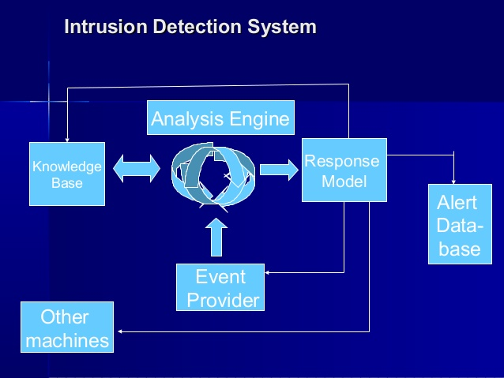

Slide 25
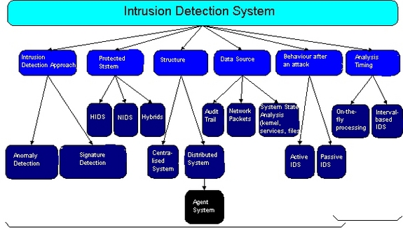
IDS Classification
Source : http://www.windowsecurity.com/articles/IDS-Part2-Classification-methods-techniques.html

Slide 26
Different ways to intrude
Buffer overflows
Unexpected combinations
Unhandled input
Race conditions

Slide 27
Top 10 Security Vulnerabilities
1 - Cross Site Scripting (XSS) XSS flaws occur whenever an application takes user supplied data and sends it to a web browser without first validating or encoding that content. XSS allows attackers to execute script in the victim's browser which can hijack user sessions, deface web sites, possibly introduce worms, etc.
2 - Injection Flaws Injection flaws, particularly SQL injection, are common in web applications. Injection occurs when user-supplied data is sent to an interpreter as part of a command or query. The attacker's hostile data tricks the interpreter into executing unintended commands or changing data.
3 - Malicious File Execution Code vulnerable to remote file inclusion (RFI) allows attackers to include hostile code and data, resulting in devastating attacks, such as total server compromise. Malicious file execution attacks affect PHP, XML and any framework which accepts filenames or files from users.
4 - Insecure Direct Object Reference A direct object reference occurs when a developer exposes a reference to an internal implementation object, such as a file, directory, database record, or key, as a URL or form parameter. Attackers can manipulate those references to access other objects without authorization.

Slide 28
5 - Cross Site Request Forgery (CSRF) A CSRF attack forces a logged-on victim's browser to send a pre-authenticated request to a vulnerable web application, which then forces the victim's browser to perform a hostile action to the benefit of the attacker. CSRF can be as powerful as the web application that it attacks.
6 - Information Leakage and Improper Error Handling Applications can unintentionally leak information about their configuration, internal workings, or violate privacy through a variety of application problems. Attackers use this weakness to steal sensitive data, or conduct more serious attacks.
7 - Broken Authentication and Session Management Account credentials and session tokens are often not properly protected. Attackers compromise passwords, keys, or authentication tokens to assume other users' identities.

Slide 29
8 - Insecure Cryptographic Storage Web applications rarely use cryptographic functions properly to protect data and credentials. Attackers use weakly protected data to conduct identity theft and other crimes, such as credit card fraud.
9 - Insecure Communications Applications frequently fail to encrypt network traffic when it is necessary to protect sensitive communications.
10 - Failure to Restrict URL Access Frequently, an application only protects sensitive functionality by preventing the display of links or URLs to unauthorized users. Attackers can use this weakness to access and perform unauthorized operations by accessing those URLs directly.

Slide 30
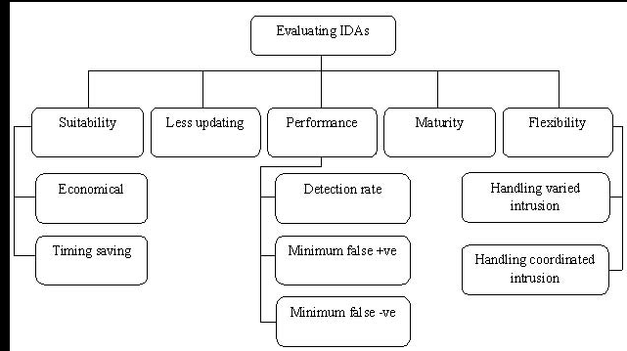
Evaluation of IDS’s

Slide 31
Intrusion Detection Systems (IDS)
Intrusion Detection Systems look for attack signatures, which are specific patterns that usually indicate malicious or suspicious intent.

Slide 32
Currently Available IDSs
Network Based IDS | Host Based IDS
Internet Security Systems Real Secure | Internet Security Systems Real Secure
Symantec Net Prowler | Symantec Intruder Alert
Network Ice Black Ice Defender | Tripwire
CyberSafe Centrax | Cyber Safe Centrax
Detection Appliance
Snort, Fragroute /Fragrouter, OSSEC HIDS, are some of the most popular Open Source IDS

Slide 33
Intrusion Detection Systems (IDS)
Different ways of classifying an IDS
IDS based on
anomaly detection
signature based misuse
host based
network based

Slide 34
Anomaly based IDS
This IDS models the normal usage of the network as a noise characterization.
Anything distinct from the noise is assumed to be an intrusion activity.
E.g flooding a host with lots of packet.
The primary strength is its ability to recognize novel attacks.

Slide 35
Drawbacks of Anomaly detection IDS
Assumes that intrusions will be accompanied by manifestations that are sufficiently unusual so as to permit detection.
These generate many false alarms and hence compromise the effectiveness of the IDS.

Slide 36
Signature based IDS
This IDS possess an attacked description that can be matched to sensed attack manifestations.
The question of what information is relevant to an IDS depends upon what it is trying to detect.
E.g DNS, FTP etc.

Slide 37
Signature based IDS (contd.)
ID system is programmed to interpret a certain series of packets, or a certain piece of data contained in those packets,as an attack. For example, an IDS that watches web servers might be programmed to look for the string “phf” as an indicator of a CGI program attack.
Most signature analysis systems are based off of simple pattern matching algorithms. In most cases, the IDS simply looks for a sub string within a stream of data carried by network packets. When it finds this sub string (for example, the ``phf'' in ``GET /cgi-bin/phf?''), it identifies those network packets as vehicles of an attack.

Slide 38
Drawbacks of Signature based IDS
They are unable to detect novel attacks.
Suffer from false alarms
Have to programmed again for every new pattern to be detected.

Slide 39
Host/Applications based IDS
The host operating system or the application logs in the audit information.
These audit information includes events like the use of identification and authentication mechanisms (logins etc.) , file opens and program executions, admin activities etc.
This audit is then analyzed to detect trails of intrusion.

Slide 40
Drawbacks of the host based IDS
The kind of information needed to be logged in is a matter of experience.
Unselective logging of messages may greatly increase the audit and analysis burdens.
Selective logging runs the risk that attack manifestations could be missed.

Slide 41
Strengths of the host based IDS
Attack verification
System specific activity
Encrypted and switch environments
Monitoring key components
Near Real-Time detection and response.
No additional hardware

Slide 42
Stack based IDS
They are integrated closely with the TCP/IP stack, allowing packets to be watched as they traverse their way up the OSI layers.
This allows the IDS to pull the packets from the stack before the OS or the application have a chance to process the packets.

Slide 43
Network based IDS
This IDS looks for attack signatures in network traffic via a promiscuous interface.
A filter is usually applied to determine which traffic will be discarded or passed on to an attack recognition module. This helps to filter out known un-malicious traffic.

Slide 44
Strengths of Network based IDS
Cost of ownership reduced
Packet analysis
Evidence removal
Real time detection and response
Malicious intent detection
Complement and verification
Operating system independence

Slide 45
Commercial ID Systems
ISS – Real Secure from Internet Security Systems:
Real time IDS.
Contains both host and network based IDS.
Tripwire – File integrity assessment tool.
Bro and Snort – open source public-domain system.

Slide 46
Bro: Real time IDS
Network based IDS
Currently developed for six Internet applications: FTP, Finger, Portmapper, Ident, Telnet and Rlogin.

Slide 47
Design goals for Bro
High-speed, large volume monitoring
No packet filter drops
Real time notification
Mechanism separate from policy
Extensible
Monitor will be attacked

Slide 48
Structure of the Bro System
Policy Script Interpreter
Real time notification
Policy script
Event Control
Event Stream
Event engine
Tcpdump filter
Filtered Packet Stream
libcap
Packet Stream
Network

Slide 49
Bro - libcap
It’s the packet capture library used by tcpdump.
Isolates Bro from details of the network link technology.
Filters the incoming packet stream from the network to extract the required packets.
E.g port finger, port ftp, tcp port 113 (Ident), port telnet, port login, port 111 (Portmapper).
Can also capture packets with the SYN, FIN, or RST Control bits set.

Slide 50
Bro – Event Engine
The filtered packet stream from the libcap is handed over to the Event Engine.
Performs several integrity checks to assure that the packet headers are well formed.
It looks up the connection state associated with the tuple of the two IP addresses and the two TCP or UDP port numbers.
It then dispatches the packet to a handler for the corresponding connection.

Slide 51
Bro – TCP Handler
For each TCP packet, the connection handler verifies that the entire TCP Header is present and validates the TCP checksum.
If successful, it then tests whether the TCP header includes any of the SYN/FIN/RST control flags and adjusts the connection’s state accordingly.
Different changes in the connection’s state generate different events.

Slide 52
Policy Script Interpreter
The policy script interpreter receives the events generated by the Event Engine.
It then executes scripts written in the Bro language which generates events like logging real-time notifications, recording data to disk or modifying internal state.
Adding new functionality to Bro consists of adding a new protocol analyzer to the event engine and then writing new events handlers in the interpreter.

Slide 53
Application Specific Processing - Finger
Tests for buffer overflow, checks the user against sensitive ids, etc
Script interpreter
Generates event controls based on the policy
Generates Finger_request event
Event Engine
Event Engine
Finger reply
Finger request

Slide 54
SNORT
Open source NIDS developed by Sourcefire
It combines the benefits of signature based and behavior based intrusion detection techniques
It has 300,000 registered users

Slide 55
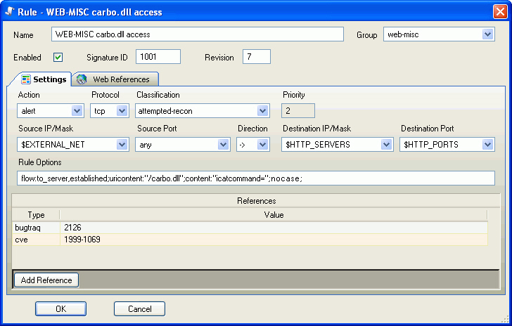
How to install SNORT (in Linux)
http://www.youtube.com/watch?v=TZ0Hj0t5b5k&feature=related
How to install and use SNORT (in XP)
http://www.youtube.com/watch?v=nAWN989WA0A&feature=related
carbo.dll is the file that can be used to remotely view any file your web server has permissions to view

Slide 56
http://www.snort.org
Need to define signatures/rules
available on internet, updated frequently
Multiple level architecture
Main application (doing analysis)
Web client – ACID (Analysis Console for Intrusion Databases)
Barnyard – analysis of results

Slide 57
Now supports preprocessor analysis
Problems with signatures
False positives – too wide a net
False negatives – too narrow a net
Preprocessors allow customizing
Start using anomaly-based detection
Customize rules based on users
Examples (see in /etc/snort/snort.conf)
stream4 – TCP statefulness, session reassembly
frag2 – packet fragmenting/reassembly
Problems
Difficult to work with, generates large amount of data

Slide 58
Future of IDS
To integrate the network and host based IDS for better detection.
Developing IDS schemes for detecting novel attacks rather than individual instantiations.

